Slide 1


Finding the Cheat Codes for Game Development
Jessica Conroy
JConroy1@Umbc.edu
Data 606 Capstone in Data Science

Slide 2
Project Overview
Goal: This project aims to investigate the features of successful video games as well as how those features have changed, or not changed, as a result of the COVID-19 pandemic.
Motivation: Gaming is a massive industry that continues to grow and develop. Identifying key features of successful games is one way to gain an edge in an extremely competitive market.
Project Plan:
Apply natural language processing techniques to summarize the descriptive game text and identify clusters of similar games.
Use clusters to investigate characteristics of games with high ownership and high review scores.

Slide 3
Project Structure
Data Acquisition
Collect Data Via API
Initial Data Cleaning
Initial EDA
Explore Data Features
Second Round of Data Cleaning and Processing
Secondary EDA
Text Analysis (Keyword Extraction, Topic Modeling)
Feature Selection and Modeling
Based on EDA results, select features for Machine Learning Model
Classification Model Training, Tuning
Text Clustering (DBSCAN, Kmeans)

Slide 4
Research Questions
What game characteristics are predictive of a high game rating?
Are these characteristics different across different genres of game?
Have these characteristics changed as a result of the covid pandemic?
Hypothesis: Multiplayer games increased in popularity

Slide 5

Background
The Gaming industry is a huge and growing market
Being competitive on that market means using the extensive data available to your advantage
This project aims to utilize metadata from Steam (a game distributor) to identify the features related to successful game creation.
Data from https://steamdb.info/stats/releases/

Slide 6

Data
Unit of Analysis: Individual games released on the Steam platform
Data Sources:
Steam Web API
list of all game IDs and names
Core game metadata
Top game reviews
Steamspy API
Supplementary metadata
APPID was used as the unique identifier to join all data into a single dataset

Slide 7
Data Pre-processing
Initial Data Cleaning:
Removed beta and test games from App list
Reformatted nested data columns (ex. Categories stored as dictionaries)
Cleaned and standardized text fields
After Initial cleaning, data consists of:
18,424 Rows
118 Columns
97 Categorical/Text
16 Numeric
5 Boolean
155 MB
3.7% of cells were missing data
High percentage of zeros, blanks, empty strings across most fields

Slide 8
Additional processing and consolidation
Filtered out rows for app types that were not games or DLC*.
Removed music, movies, advertising, demos, etc.
Filtered out games that are “Coming Soon” and created year field from release date
Dropped categories/genres that had fewer than 50 games
Final dataset:
14,952 Rows
79 variables
2.1% missing data
DLC = Downloadable content, add on or extensions for existing games

Slide 9
Data Key Features
Feature | Data Type | Feature Description
AppID | Numeric | Unique App identifier
Name | String | Name of App
Required age | Numeric | Age required to play
Is free | Boolean | Whether or not game is free
Detailed Description | String | Detailed game description
Short Description | String | Short Game Description
Release Date | String | Date of Game Release
Review Score | Numeric | Weighted steam user review scores
Top Reviews by Upvotes | String | Text of the top reviews (max 20) for a game

Slide 10
Data Key Features Cont’d
Feature | Data Type | Feature Description
Positive | Numeric | Count of positive reviews
Negative | Numeric | Count of negative reviews
Owners | Categorical | Range of values representing the number of people who own an app
Price | Numeric | Price of game now
Initial Price | Numeric | Price of game on release
Discount | Numeric | Discount on the game price
Tags | String | Hashtags given to the game
Category and Genre Fields | Binary | Binary fields indicating if a game falls into particular genres or categories.
Release Date | String | Date when game was released
Release Year | String | Year when game was released

Slide 11
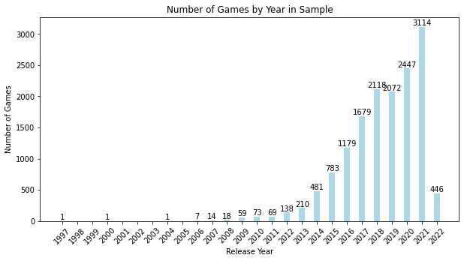
Exploratory Analysis – Key Data Features
Release Year
The Pre and During COVID-19 analyses will require analyzing data from 2018 2019 and comparing to 2021 and 2022.
Pre-COVID-19: 4,190
During-COVID-19: 3,560
This exploratory analysis will inform whether or not pre-COVID data is used in the ML model development stage of this project.
One limitation of this analysis is that games that have been out longer are more likely to have a larger corpus of review text. This is one potential confound for our text analysis to keep in mind later.

Slide 12
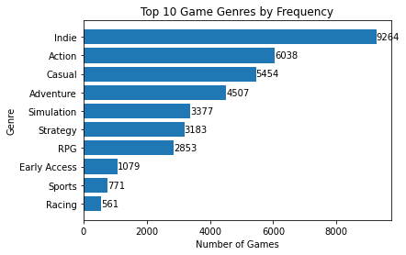
Exploratory Analysis
Games by Genre
Game genre and category are key features segmenting the data.

Slide 13
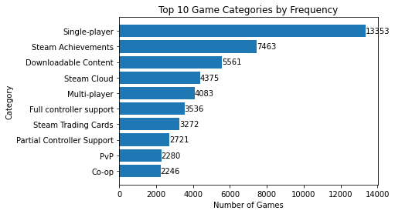
Exploratory Analysis
Games by Category
Game genre and category are key features segmenting the data.

Slide 14
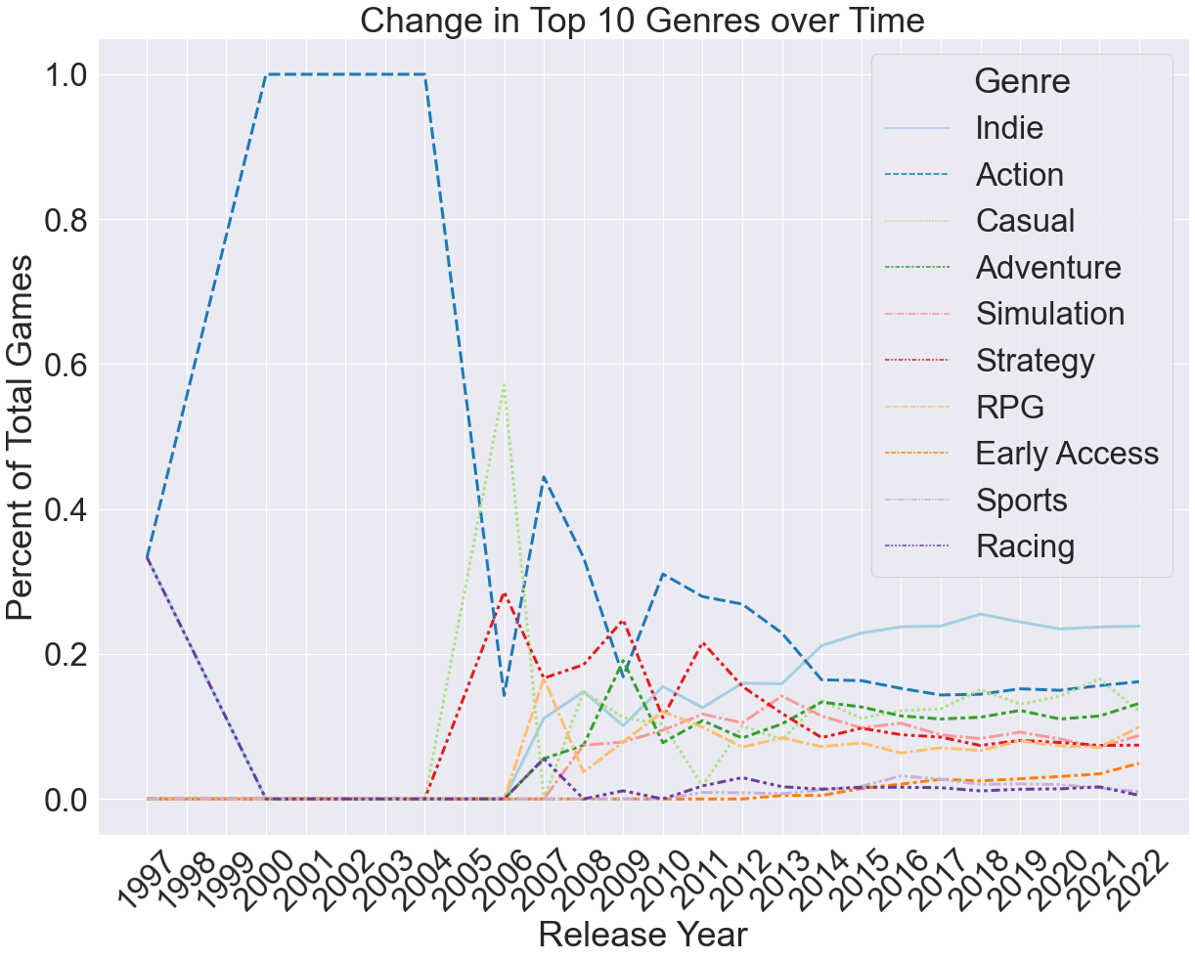
Exploratory Analysis – Change over Time
Most games released are Indie and or Action games, followed by Casual, Adventure and RPGs.
Over time Indie games have overtaken action games as the biggest genre

Slide 15
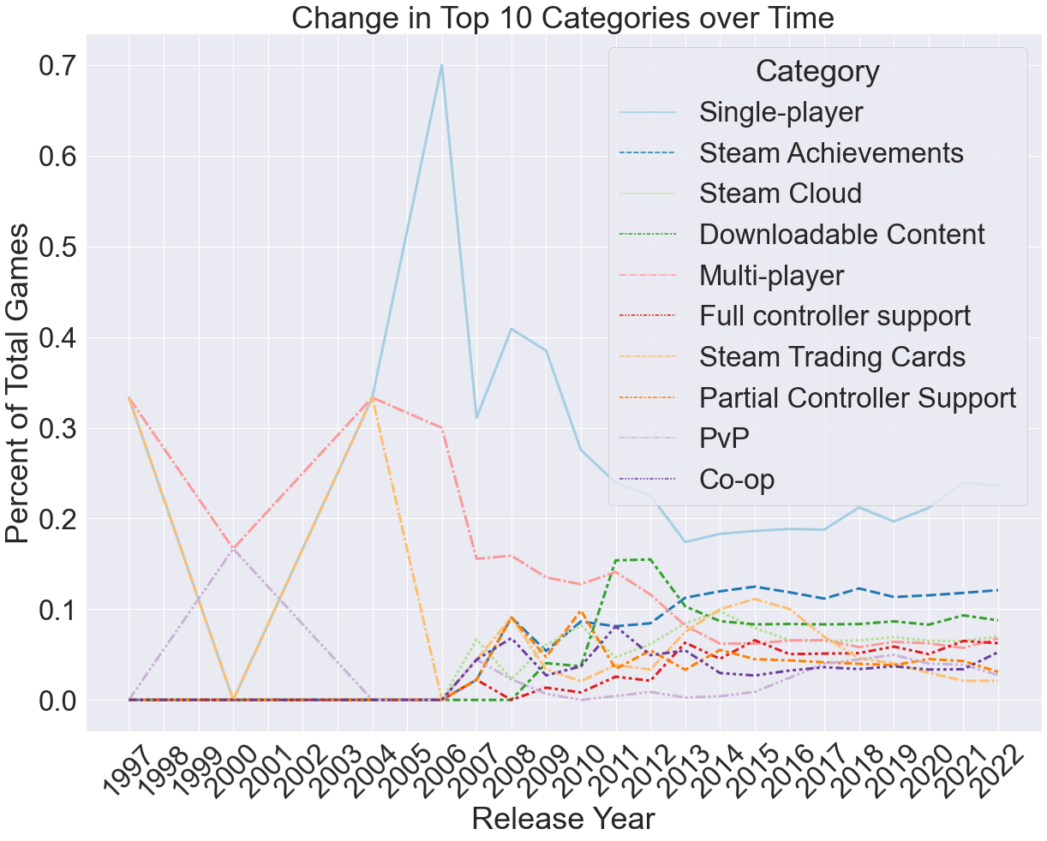
Exploratory Analysis – Change over Time
Single Player games have remained the most common game type released. The proportion of single player games are trending up.

Slide 16
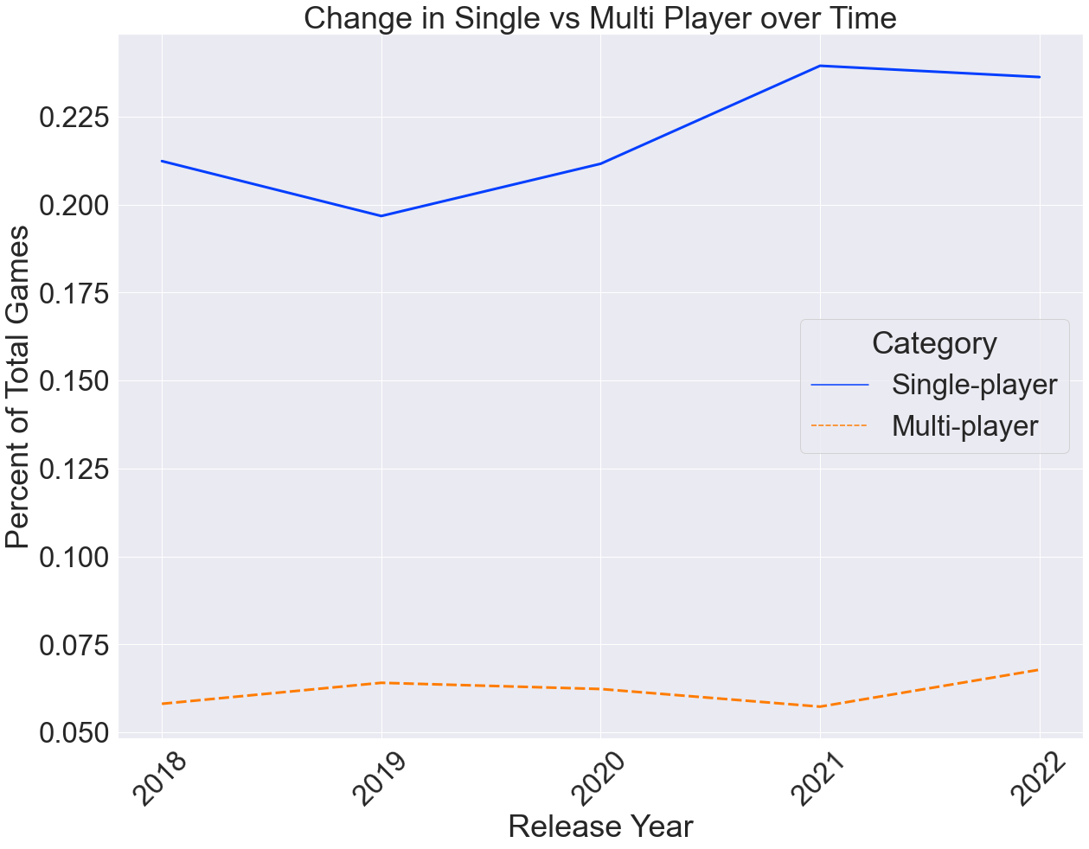
Exploratory Analysis – Change over Time
When comparing the proportion of games released in the last 5 years, both Single and multi-player games have trended up, but the change in single player games was more dramatic.
While interesting, this does not contradict my hypothesis that multiplayer games are more popular since the pandemic started. (This may indicate that single player games are simply easier to produce).

Slide 17
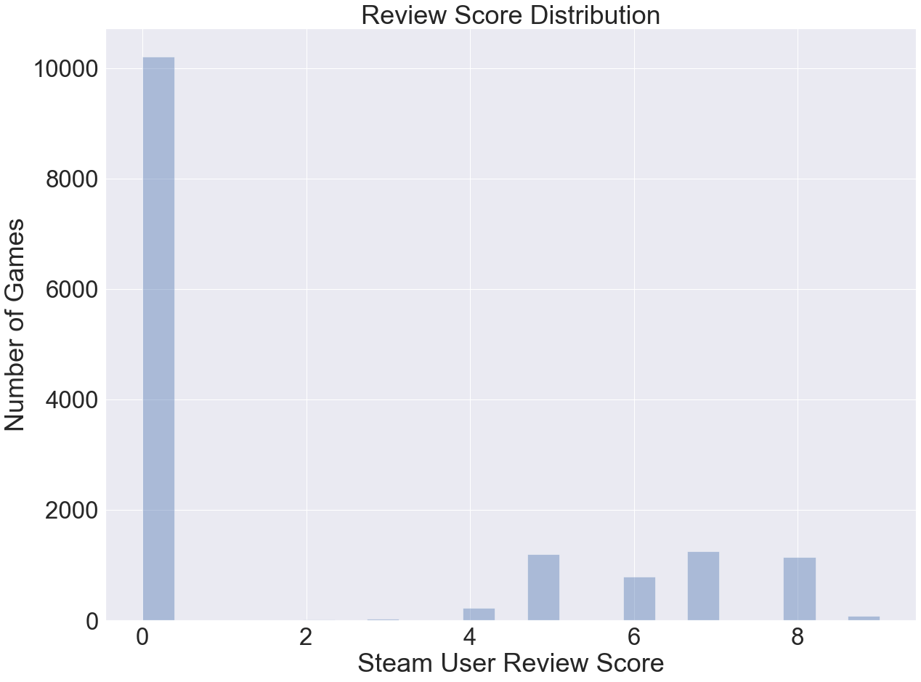
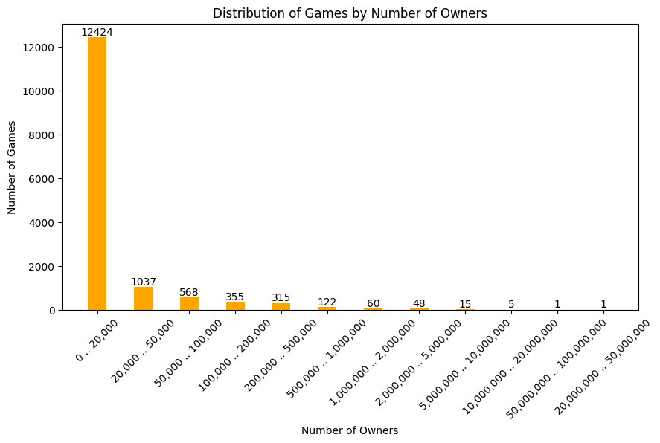
Potential Target Features
Summary of Findings
Review Score values of Zero represent missing reviews
Number of Owners is very right skewed. Training a model with that as the target will require management of uneven sampling.

Slide 18
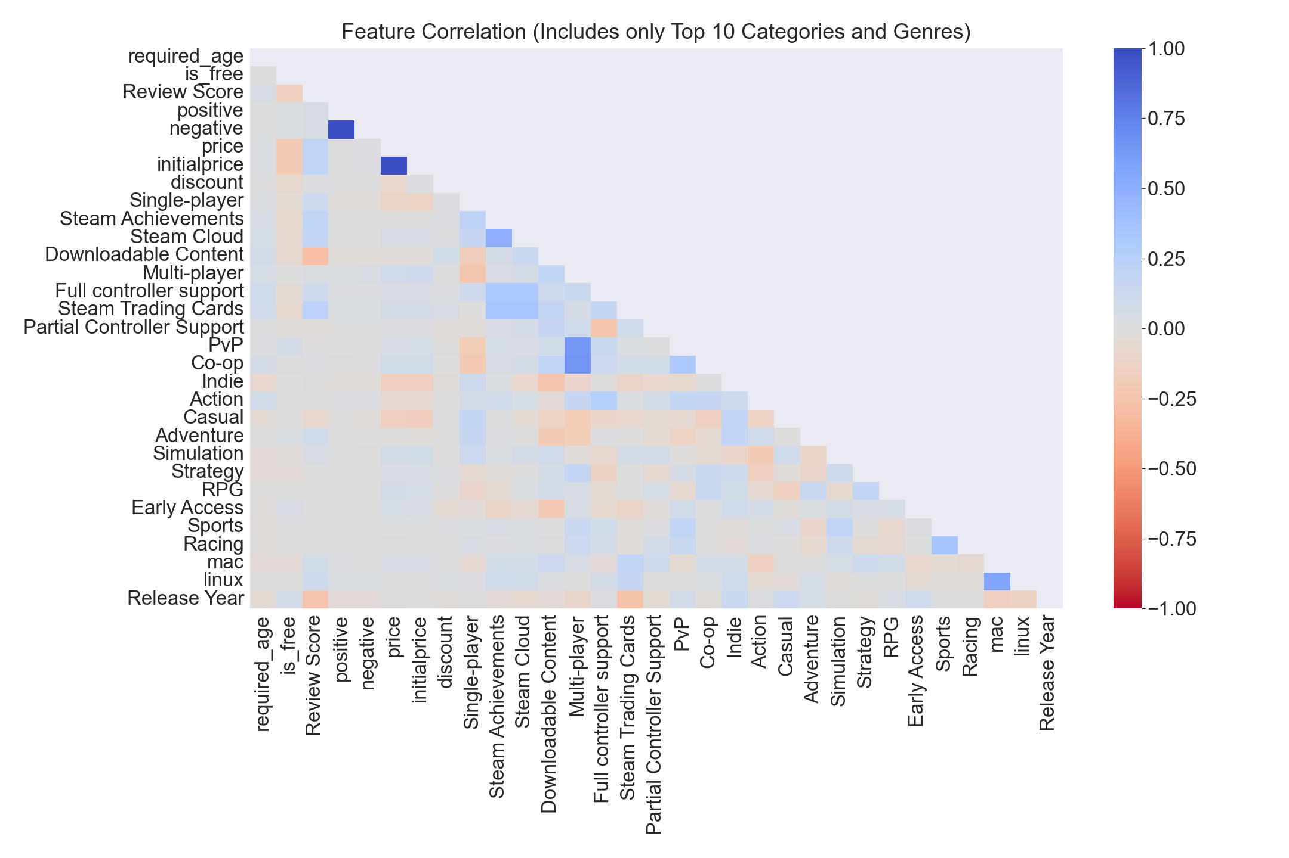
Feature Correlations
In addition to its correlation with positive and negative review counts, Review Score has small positive correlation with DLC and negative correlation with price and other category types. but no other significant features.
When looking at all categories and genres, several of the groups are correlated with each other as well.

Slide 19
Keyword Extraction
Data sets:
Full Steam Data
preCOVID Data (2018-2019)
4190 Games
COVID Data (2021-2022)
3560 Games
Methods:
TFIDF Vectorization and Ngram Analysis
Note: CountVectorization and TFIDF returned similar results
Yake Keyword Extraction
Spacy Keyword Extraction

Slide 20
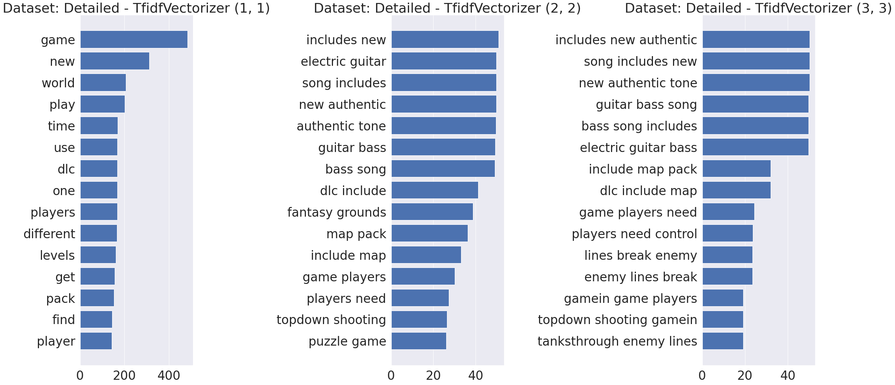
TFIDF Vectorization and Ngram Analysis
Detailed Description Text

Slide 21

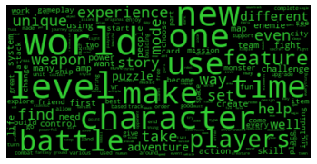
Description Text Word Frequencies

Slide 22
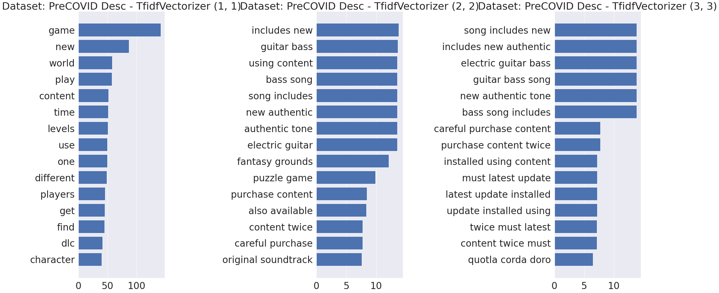
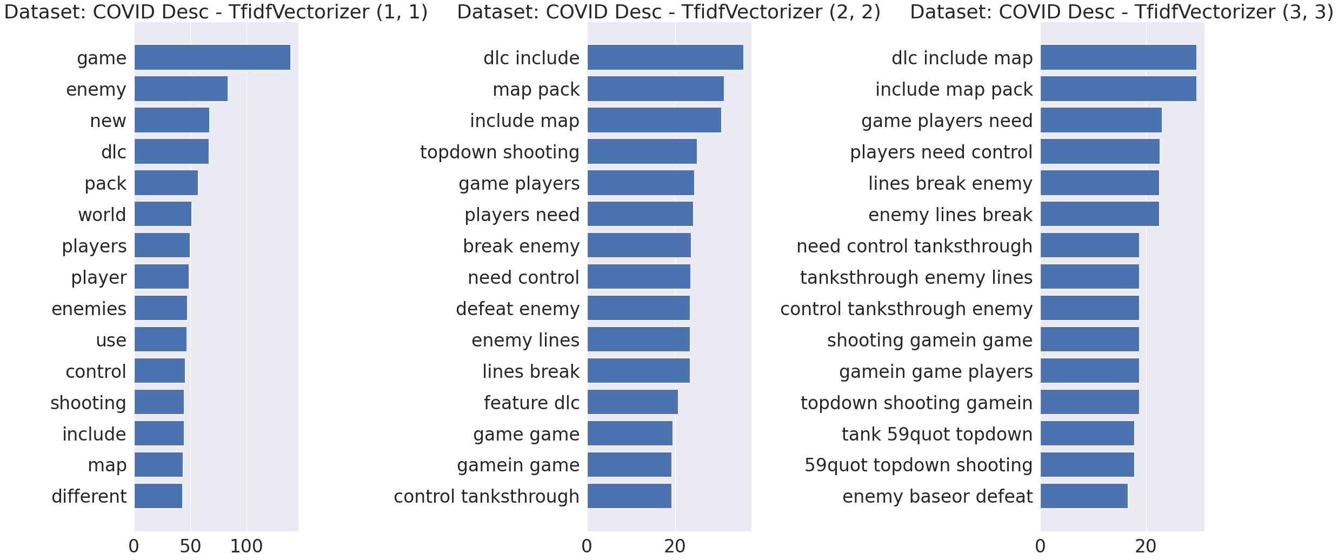
TFIDF Vectorization and Ngram Analysis
PreCOVID vs COVID Comparison
PreCOVID
COVID

Slide 23
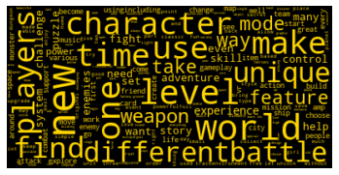
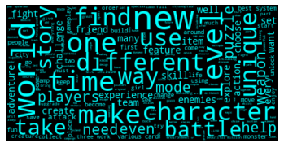
Description Text Word Frequencies Pre and During Covid

Slide 24
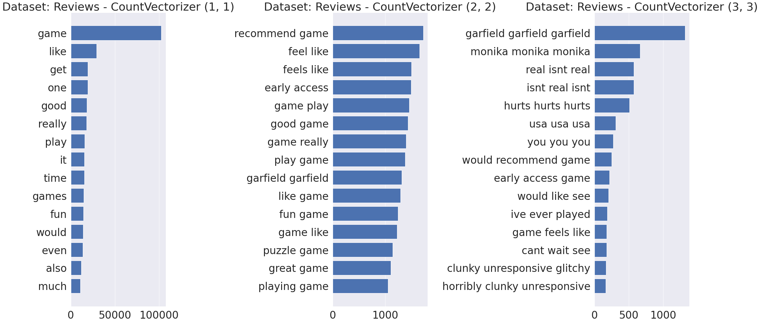
TFIDF Vectorization and Ngram Analysis
Review Text

Slide 25
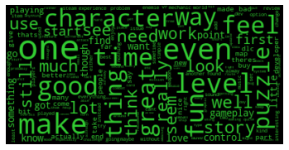
Review Text Word Frequencies

Slide 26
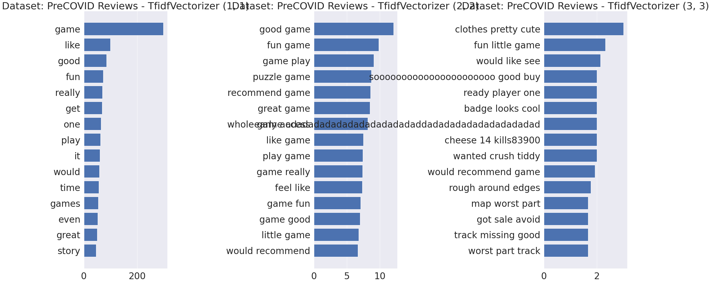
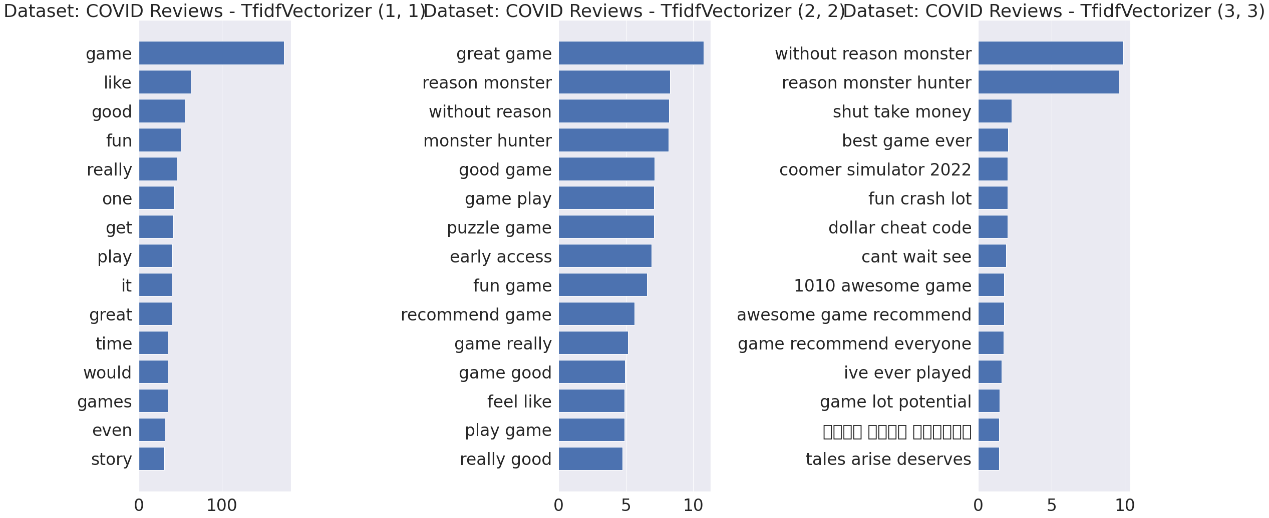
TFIDF Vectorization and Ngram Analysis
PreCOVID vs COVID Comparison
PreCOVID
COVID

Slide 27
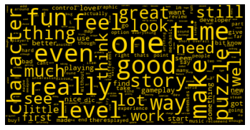
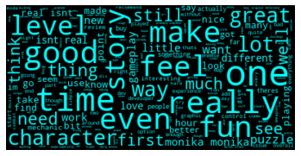
Review Text Word Frequencies Pre and During Covid

Slide 28
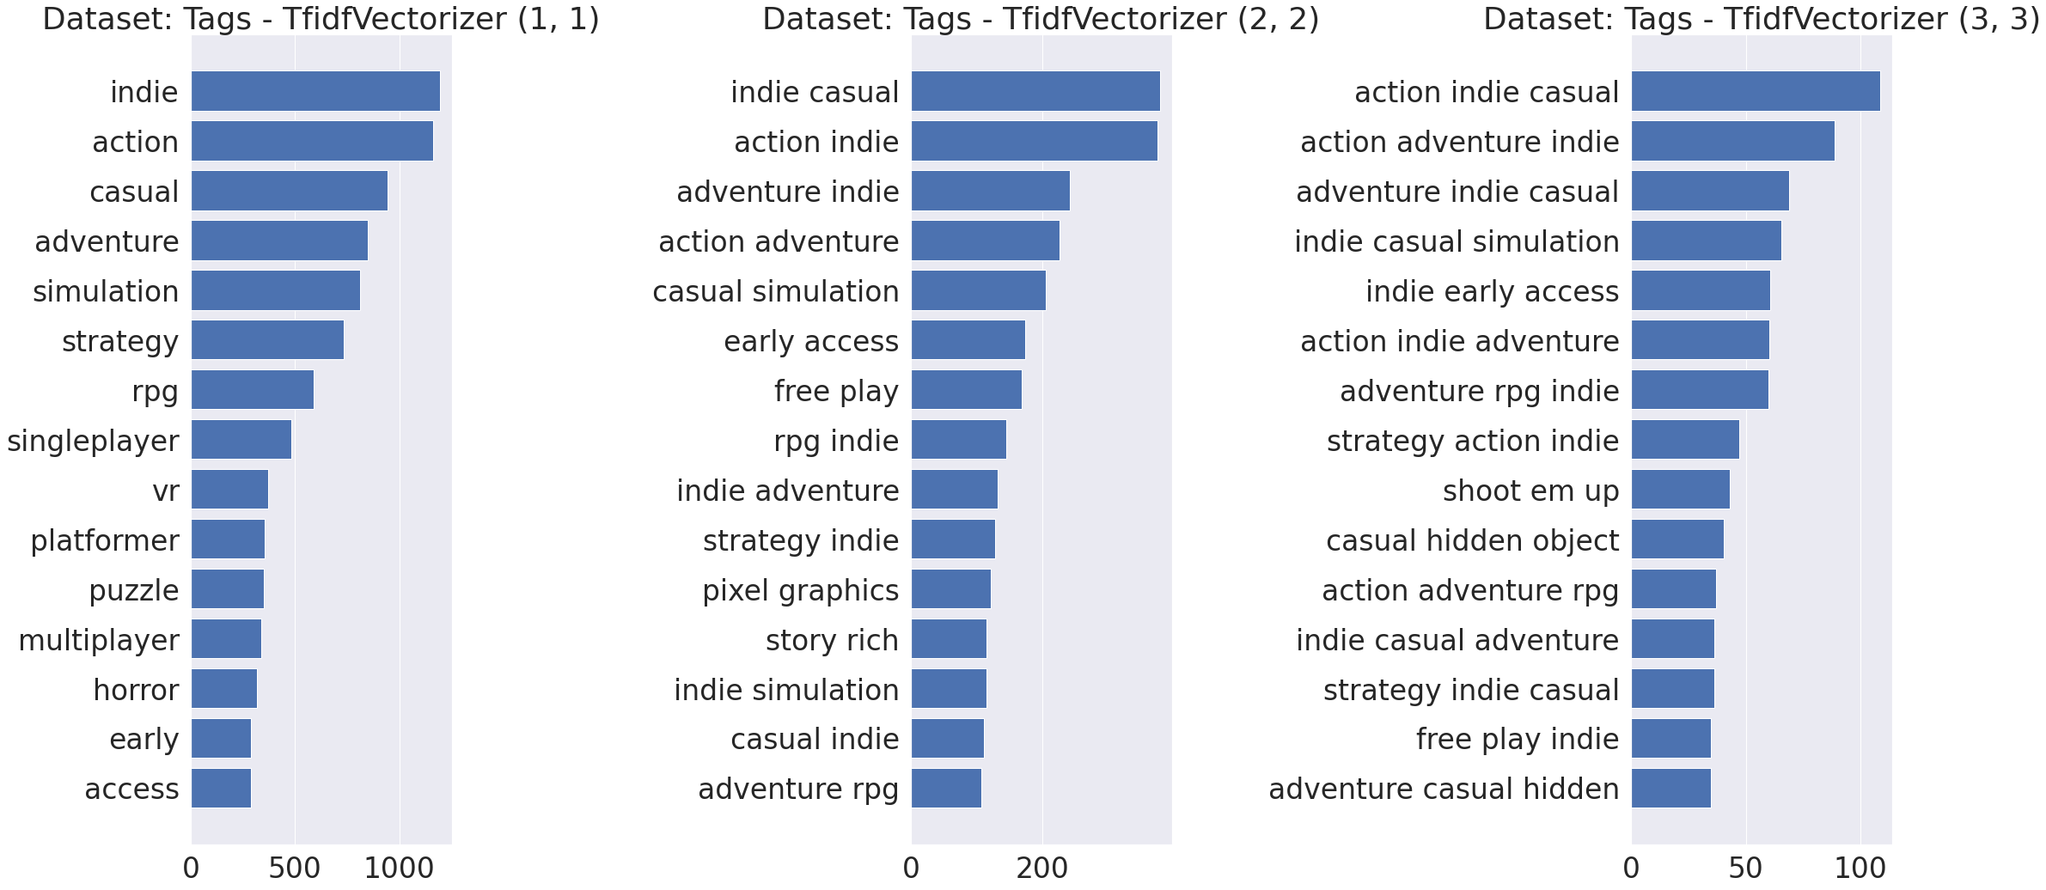
TFIDF Vectorization and Ngram Analysis
Tags

Slide 29
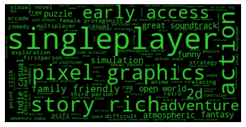
Game Tag Word Frequencies

Slide 30
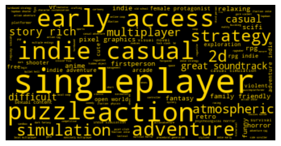
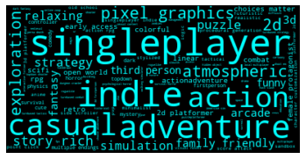
Review Text Word Frequencies Pre and During Covid

Slide 31
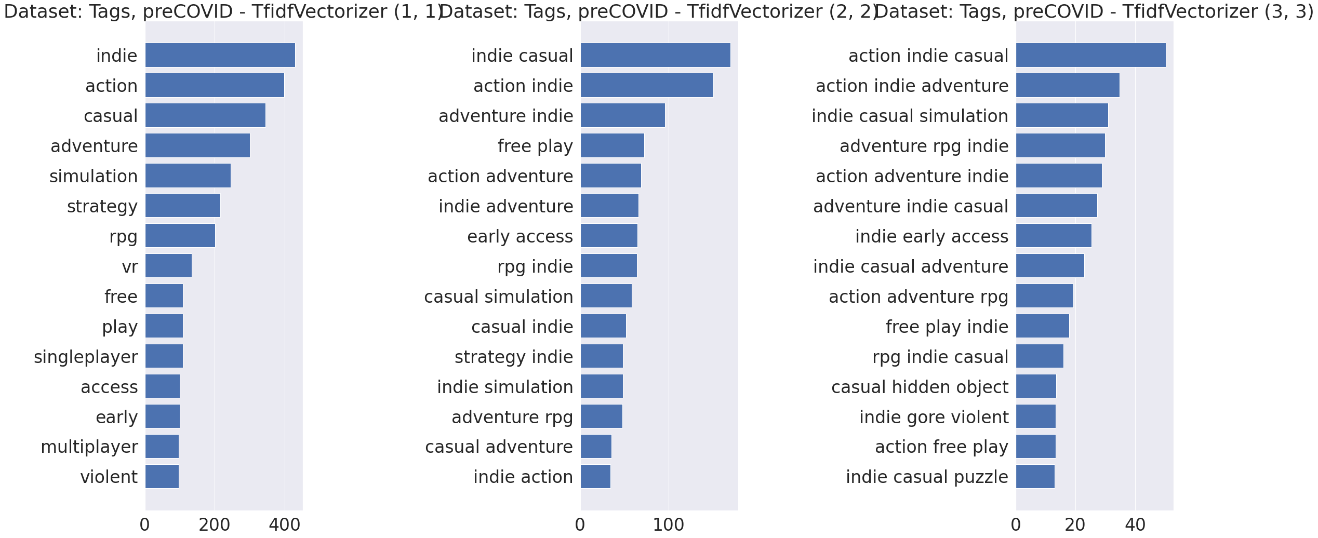
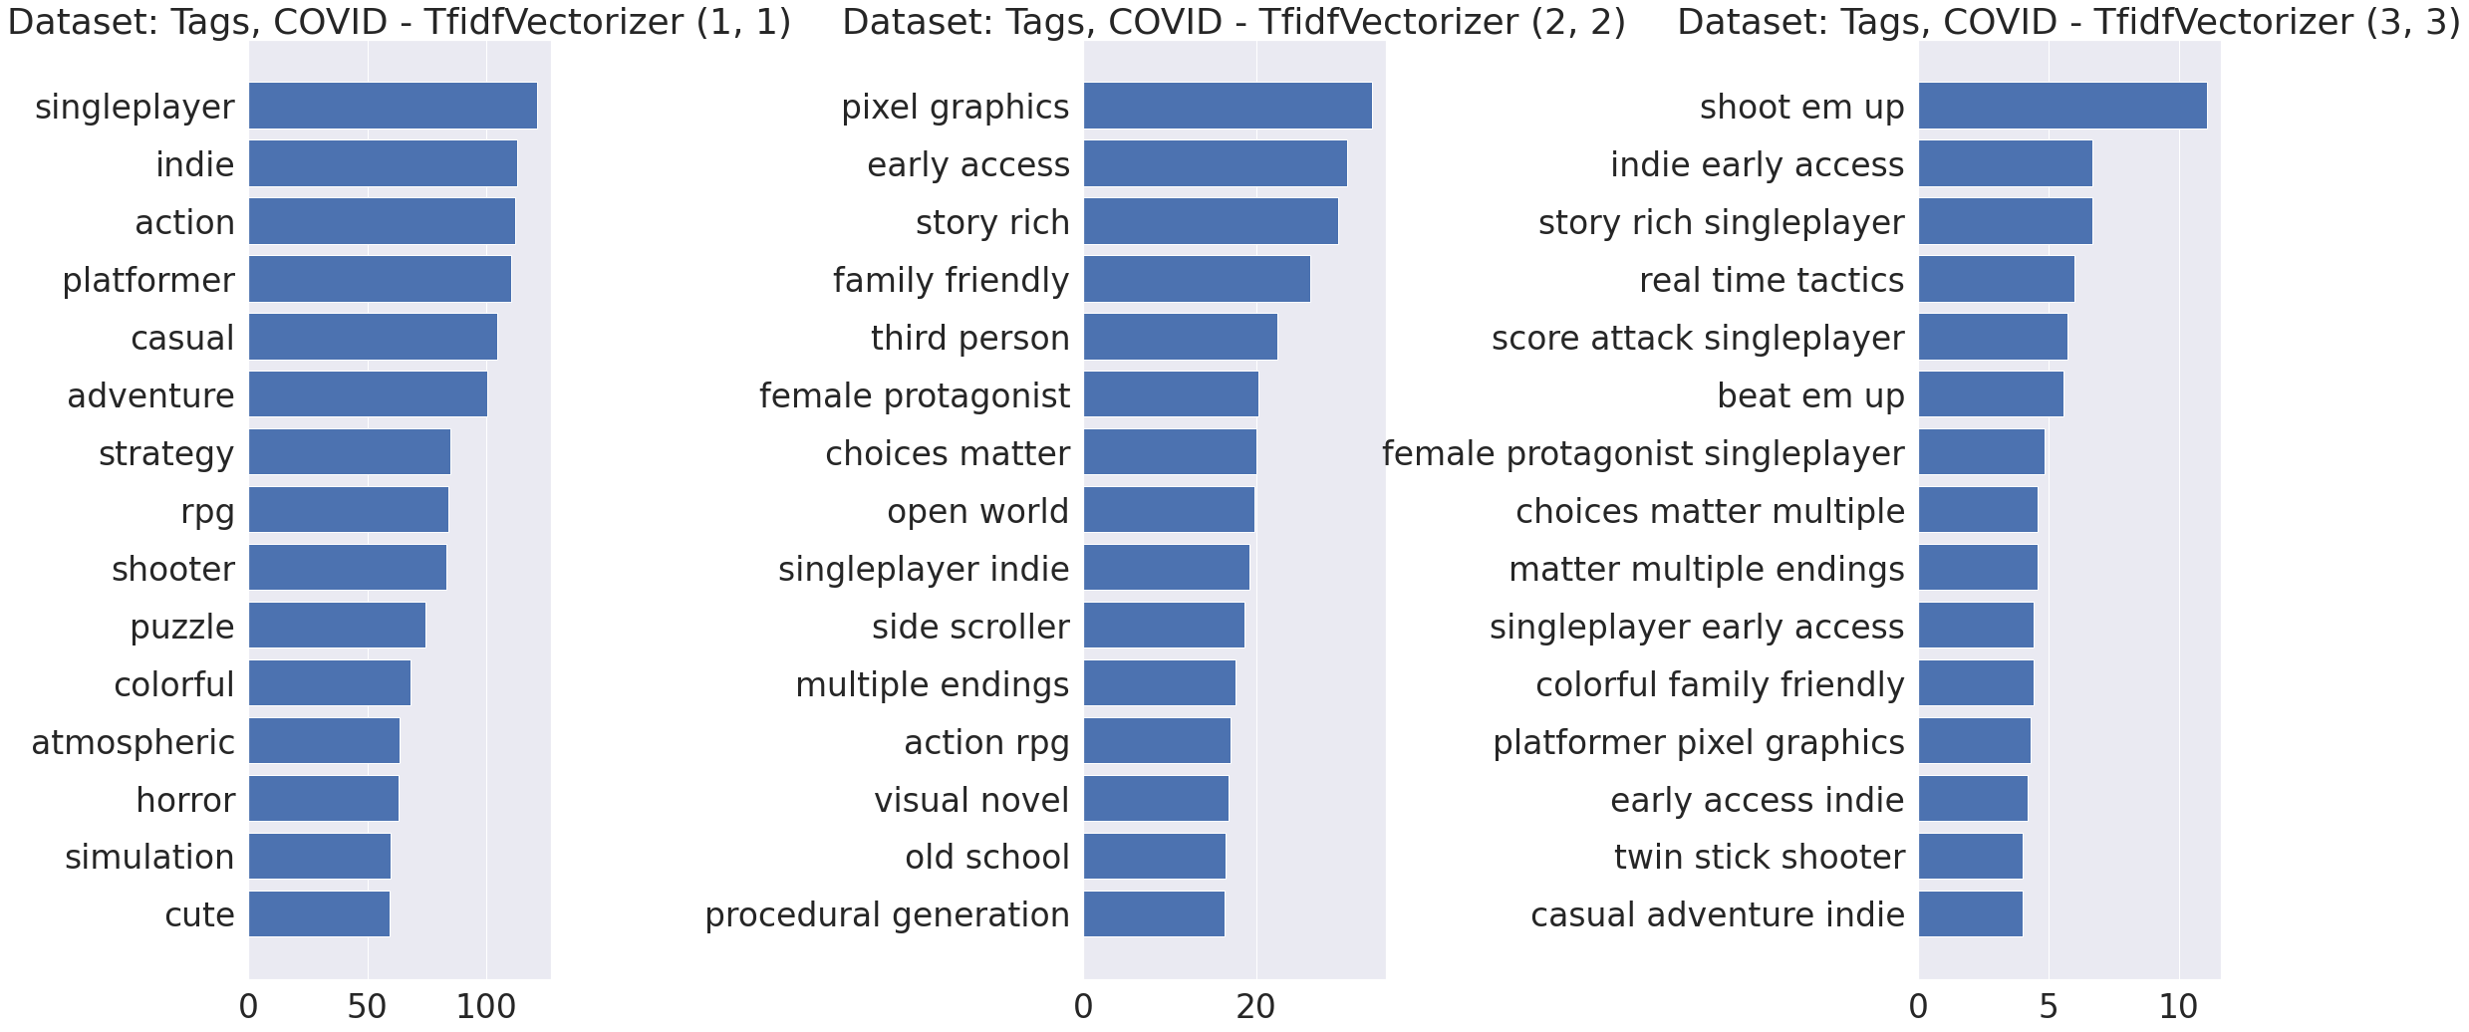
TFIDF Vectorization and Ngram Analysis
PreCOVID vs COVID Comparison
PreCOVID
COVID

Slide 32
Yake Keyword Extraction
Description | Reviews | Tags
include map pack | good good bad | action indie casual
dlc include map | good | action adventure indie
fantasy grounds full | time | action indie adventure
time fantasy grounds | pretty good | adventure indie casual
time purchase fantasy | good bad bad | indie action adventure
grounds full ultimate | good story good | indie casual simulation
feature dlc include | lot fun | indie casual adventure
world | good graphics good | casual action indie
designed fantasy grounds | play good good | indie casual action
object puzzle adventure | good time | adventure action indie
https://github.com/LIAAD/yake
https://www.sciencedirect.com/science/article/abs/pii/S0020025519308588

Slide 33
Yake Keyword Extraction - preCOVID
Description | Reviews | Tags
fantasy grounds full | good | action indie casual
time purchase fantasy | time | action indie adventure
designed fantasy grounds | pretty good | action adventure indie
time fantasy grounds | fun | adventure indie casual
grounds full ultimate | good good bad | indie casual simulation
world | lot fun | indie action indie
time | good time | indie casual adventure
fantasy grounds features | great | indie casual action
object puzzle adventure | make | indie action adventure
purchase fantasy grounds | level good time | casual action indie
https://github.com/LIAAD/yake
https://www.sciencedirect.com/science/article/abs/pii/S0020025519308588

Slide 34
Yake Keyword Extraction – during COVID
Description | Reviews | Tags
include map pack | monika monika monika | singleer action adventure
dlc include map | real isnt real | singleer indie action
feature dlc include | isnt real isnt | singleer indie casual
enemy lines break | monika monika | story rich singleer
lines break enemy | isnt real | singleer early access
control tanksthrough enemy | real isnt | singleer indie adventure
enemy tanks feature | good good bad | singleer casual adventure
control tanks enemy | good | singleer adventure casual
number enemies shooting | time | indie singleer casual
include mission pack | fun | singleer action casual
https://github.com/LIAAD/yake
https://www.sciencedirect.com/science/article/abs/pii/S0020025519308588

Slide 35
spaCy Keyword Extraction
Description | Reviews | Tags
new uniforms | desktop game | indie adventure free play
many meeple | 4 episodes game | indie early access adventure fps fantasy great soundtrack shooter firstperson
whole family | wasok simple first gradually levels | realistic cinematic abstract action indie singleplayer comedy multiplayer online coop local multiplayer
annoying questions | developers platformers | dark pve procedural generation singleplayer strategy simulation action shooter fps d firstperson
eldora speedway volusia | higher speeds | pixel graphics retro adventure rpg arcade
pretty easygoing sleeping customers | handle cards | indie adventure dark puzzle singleplayer action great soundtrack atmospheric platformer story rich puzzleplatformer d mystery runner dystopian scifi side scroller
bacon | fine stages | funny great soundtrack platformer retro
10 experienceplayers | funky colour boke | gore third person
142x142 | stanier class 5 congrats | flight procedural generation parkour exploration third person
four | censoring | medieval

Slide 36
spaCy Keyword Extraction – Pre-COVID
Description | Reviews | Tags
good luck marinefeatures old school shooter action autoheal | dlcawesome game | indie strategy rpg
activatable items | really excellent coaching strategy simulation endeavour game | casual
combat themresources | bit three initial characters | partybased rpg casual simulation strategy rpg
naked girls | better imho crescendo | horror
realtimecustom soundtrack | middle instead old working side pieces | casual strategy simulation
neutral care application | stuff | vr adventure nudity visual novel anime casual indie strategy simulation
career vigilante | appealing looks | shooter survival casual hidden object adventure
valerie cosplayed by「星之迟迟」 holborn cosplayed by「沧霁桔梗」 annemarie | 400 cars | linear singleplayer short actionadventure early access
backpack | kind thank youone advanced locos | wargame beautiful firstperson
142x142 | blender | indie lgbtq

Slide 37
Spacy Keyword Extraction – COVID
Description | Reviews | Tags
fierce battles | world great game | rich coop multiplayer
retro soundtrackwe’re mad herewelcome world strange fairy taleswe | solid foundation good game | female protagonist loot
historically accurate orders battle | good view | gridbased movement adventure logic
dozens hours | great graphics effects | open world
old concept humorism | recommended gpu memory requirements | puzzle jrpg anime
five authentic special 50th anniversary liveries | crazy 3d | dungeon crawler rpg
camisolethe hour witch chapter | holes wall | sports arcade
farmer harvest crops | novas mecânicas | cartoon cartoony
sharlotte holmes rising notoriety | these feeding | dinosaurs
interiors | four | bowling

Slide 38
EDA Key Findings
Initial analysis of pre-COVID and during COVID data do not reveal clear differences
Indie action games are the most common
Single-player games are far more common than other types of games
spaCy keyword extraction performed better than YAKE extraction

Slide 39
Next Steps
Topic Modeling
Latent Dirichlet Allocation (LDA) and Non-negative Matrix Factorization (NMF)
Clustering
Density-based spatial clustering of applications with noise (DBSCAN)
K-Means
Feature Selection
Machine Learning Model Selection
Classic neural network (multi-layer perceptron)
Notes:
DBSCAN - Density-Based Spatial Clustering of Applications with Noise. Finds core samples of high density and expands clusters from them.

Slide 40
References
Global Frontier Report—Google for Games. (n.d.). Retrieved February 6, 2022, from https://games.withgoogle.com/reports/
Global Insights Report—Google for Games. (n.d.). Retrieved February 6, 2022, from https://games.withgoogle.com/reports/insightsreport/
Number of games released on Steam 2021. (n.d.). Statista. Retrieved February 6, 2022, from https://www.statista.com/statistics/552623/number-games-released-steam/
Video game market value worldwide 2015. (n.d.). Statista. Retrieved February 6, 2022, from https://www.statista.com/statistics/292056/video-game-market-value-worldwide/
https://towardsdatascience.com/keyword-extraction-process-in-python-with-natural-language-processing-nlp-d769a9069d5c
https://colab.research.google.com/github/explosion/spacy-notebooks/blob/master/notebooks/conference_notebooks/pydays/topic_modelling.ipynb
https://partner.steamgames.com/doc/webapi/ISteamApps
https://steamspy.com/api.php
https://steamdb.info/stats/releases/
https://github.com/ydataai/pandas-profiling
Blei, D. M., Ng, A. Y., & Jordan, M. I. (2003). Latent Dirichlet Allocation. Journal of Machine Learning Research, 3(Jan), 993–1022.
Carbonetto, P., Sarkar, A., Wang, Z., & Stephens, M. (2021). Non-negative matrix factorization algorithms greatly improve topic model fits. https://arxiv.org/abs/2105.13440v2
Lee, D. D., & Seung, H. S. (1999). Learning the parts of objects by non-negative matrix factorization. Nature, 401(6755), 788–791. https://doi.org/10.1038/4456
Mahata, D., Shah, R. R., Kuriakose, J., Zimmermann, R., & Talburt, J. R. (2018). Theme-Weighted Ranking of Keywords from Text Documents Using Phrase Embeddings. 2018 IEEE Conference on Multimedia Information Processing and Retrieval (MIPR), 184–189. https://doi.org/10.1109/MIPR.2018.00041
Miah, M. S. U., Sulaiman, J., Sarwar, T. B., Zamli, K. Z., & Jose, R. (2021). Study of Keyword Extraction Techniques for Electric Double-Layer Capacitor Domain Using Text Similarity Indexes: An Experimental Analysis. Complexity, 2021, e8192320. https://doi.org/10.1155/2021/8192320

